Slide 1
CSE 524: Advanced Project - II
A Fast Triangle-Triangle Intersection Test for Collision - Implementation
Roopak Narayanasamy
114941190

Slide 2
Introduction
This research is mainly focused on bring up a method for computing whether two triangles in a 3-Dimention will intersect or not and for the collision test as well.
Taking the ideas proposed by z` Muller, trying to implement the fast triangle-triangle intersection test initially, then used the collision algorithm.
Implementation is done in C++.

Slide 3
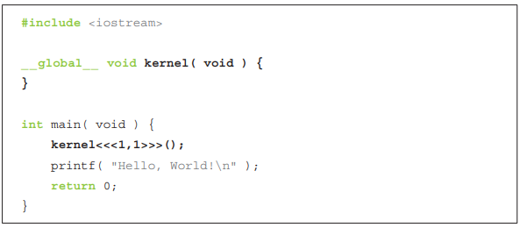
CUDA Programming
Learnt what is CUDA programming.
Got used to CUDA programming by running sample programs.
Normally all the programs wee write is compiler in host, which uses CPU and the system memory to compile.
Using _global_ function tells the compiler that this
program runs in device not the host.

Slide 4
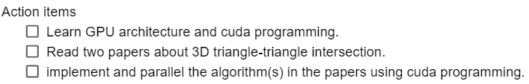
Proposed Work
Implement A fast Triangle-Triangle intersection for collision detection.
Work in CUDA.
Paper link - https://webee.technion.ac.il/people/cgm/Computer-Graphics-Multimedia/Publications/Papers/2006/2006_A_Fast_Triangle_to_triangle_Intersection_Test_for_Collision.pdf

Slide 5
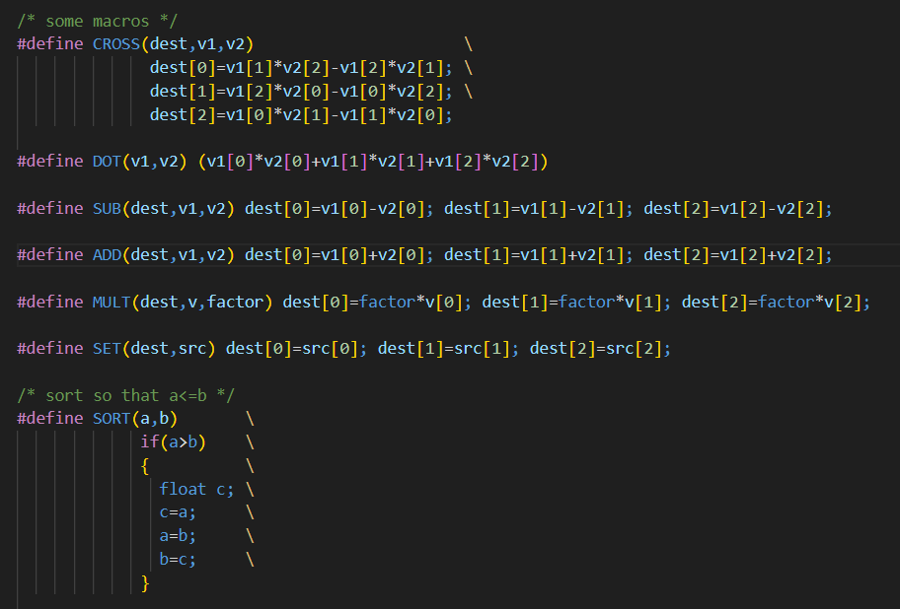
Implementation - Advanced Project I
Firstly, implemented the algorithm proposed in Thomas Muller paper to find whether two triangles are intersecting.
The paper proposed by Thomas Muller includes many mathematical formulas to find whether 2 fast triangles intersect or not.
Defined various macros for easier use.
MACROS used: CROSS, DOT, ADD, SUB, MULT, SET, SORT.

Slide 6
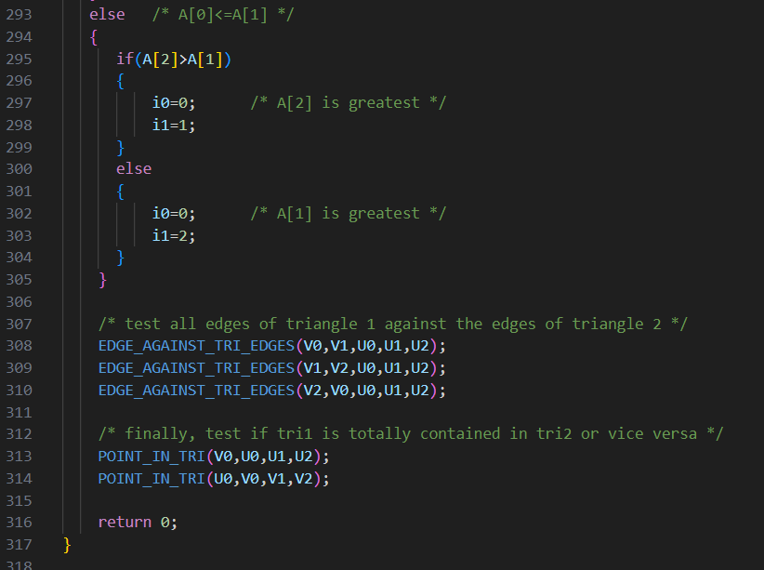
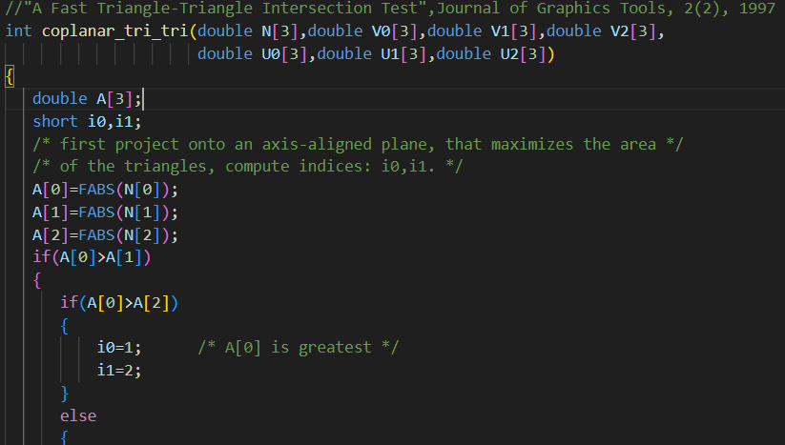
Algorithm used to implement Tomas Moller approach.

Slide 7
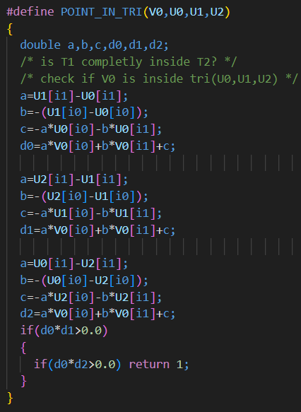
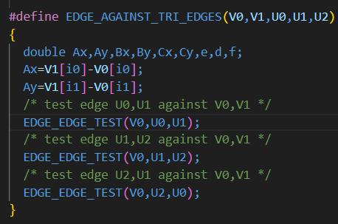

Slide 8
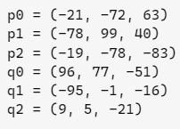
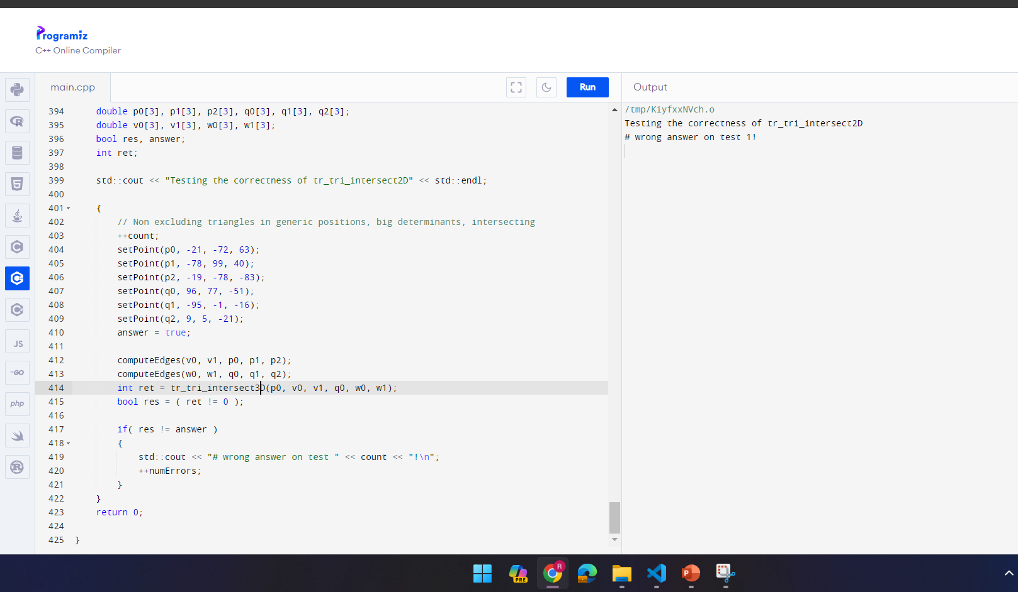
Sample data and Result for the data
Got this data points from stackoverflow, where one have used this data points to see if two triangles intersect.
Obtained required result but, the computation time was high since there were many mathematical equations to solve.

Slide 9
Advanced Project – II
Came across “A Fast Triangle to Triangle Intersection Test for Collision Detection by Oren Tropp et.al” and found their approach had less computation and mathematical equations.
Paper link: https://webee.technion.ac.il/people/cgm/Computer-Graphics-Multimedia/Publications/Papers/2006/2006_A_Fast_Triangle_to_triangle_Intersection_Test_for_Collision.pdf

Slide 10
Implementation
Algorithm:
1: Find the parameters βi , 1 ≤ i ≤ 3 using determinants.
2: If no legal βi’s exist, conclude that there is no intersection and exit.
3: Construct the segment of intersection between triangle A and the plane of B.
4: If this segment intersects triangle B, the triangles intersect.
5: If desired, construct the segment of intersection between the two triangles as linear combinations of the parameters found.

Slide 11
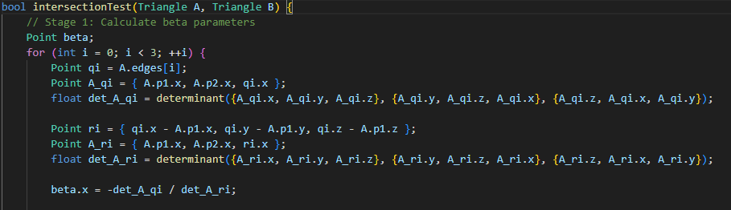
Implementation
The algorithm has 4 stages which is essential for finding the intersection of two 3D triangles.
Stage 1: Calculating beta parameters

Slide 12

Implementation
Stage 2: Checking for legal beta values
Stage 3: Constructing intersection segment

Slide 13
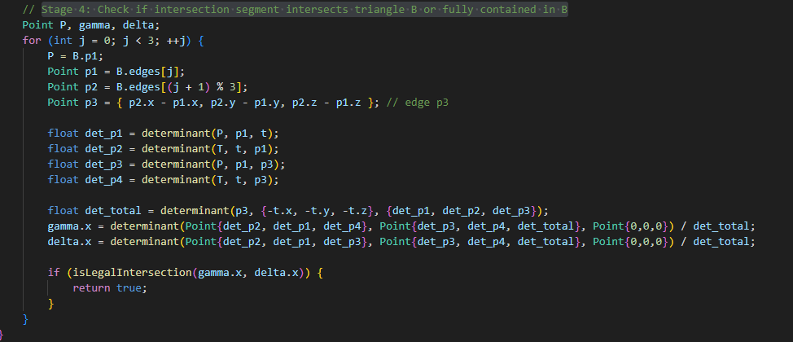
Implementation
Stage 4: Check if intersection segment intersects triangle B or fully contained in B.

Slide 14
Implementation
These 4 stage when computer will return whether two triangles are intersecting.
The dataset is obtained form a github link: https://github.com/hubmapconsortium/hra-tissue-block-annotation/blob/main/model/plain_manifold_filling_hole_v1.4/VH_F_Kidney_L/VH_F_renal_pyramid_L_a.off.
So, two files “VH_F_renal_pyramid_L_a” and “VH_F_renal_pyramid_L_a” as points for Triangle A and B respectively.
Returning true if any of the point in both the triangle intersects with each other, other wise false.

Slide 15
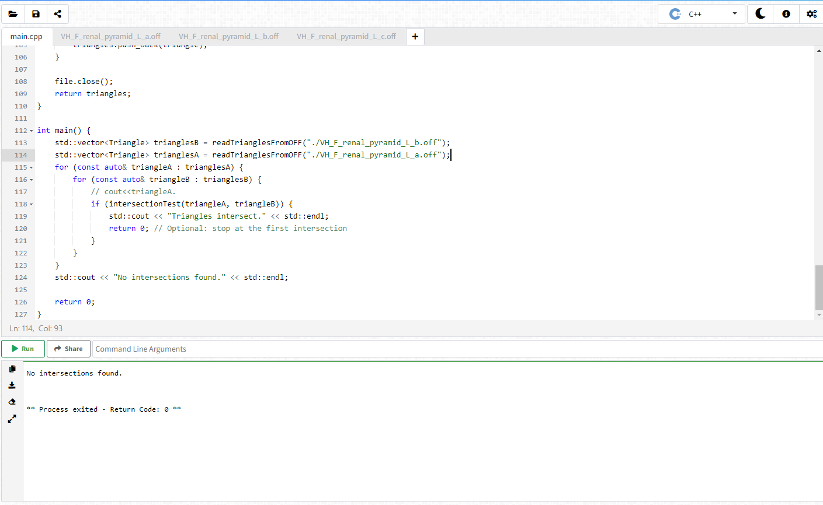
Results – C++

Slide 16
Implementation - CUDA
Tried to implement the same C++ algorithm, into GPU for faster compiling and more efficiency.
Things to look out for while changing from C++ to CUDA:
Identify Parallelizable Parts: parallelization of intersectionTest function, as it processes each pair of triangles independently.
Rewrite Kernel: Rewrite the intersectionTest function as a CUDA kernel. This involves modifying the function to operate on GPU memory and adding CUDA-specific annotations.
Memory Management: Allocate memory on the GPU for the triangles and transfer data between the CPU and GPU memory using CUDA memory management functions.
Launch Kernel: After rewriting the intersectionTest function as a CUDA kernel, launch it from the CPU code. CUDA kernels are launched with a specific number of threads per block and a specific number of blocks.

Slide 17
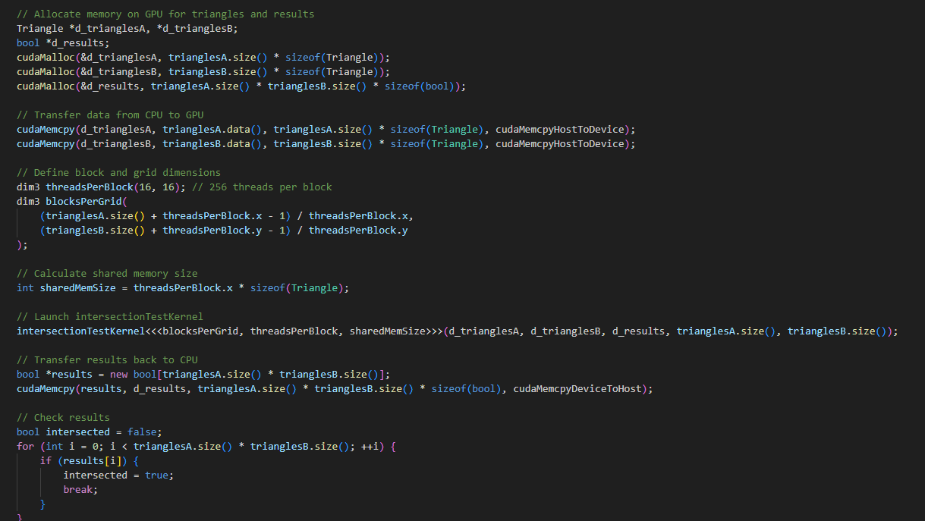

Slide 18
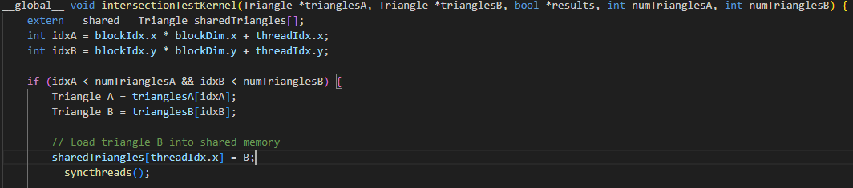
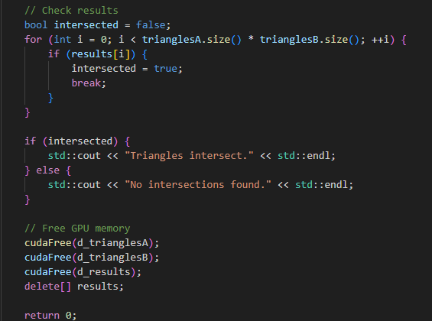

Changes I made to the C++ code that runs in CPU.

Slide 19
THANK YOU

